Slide 1


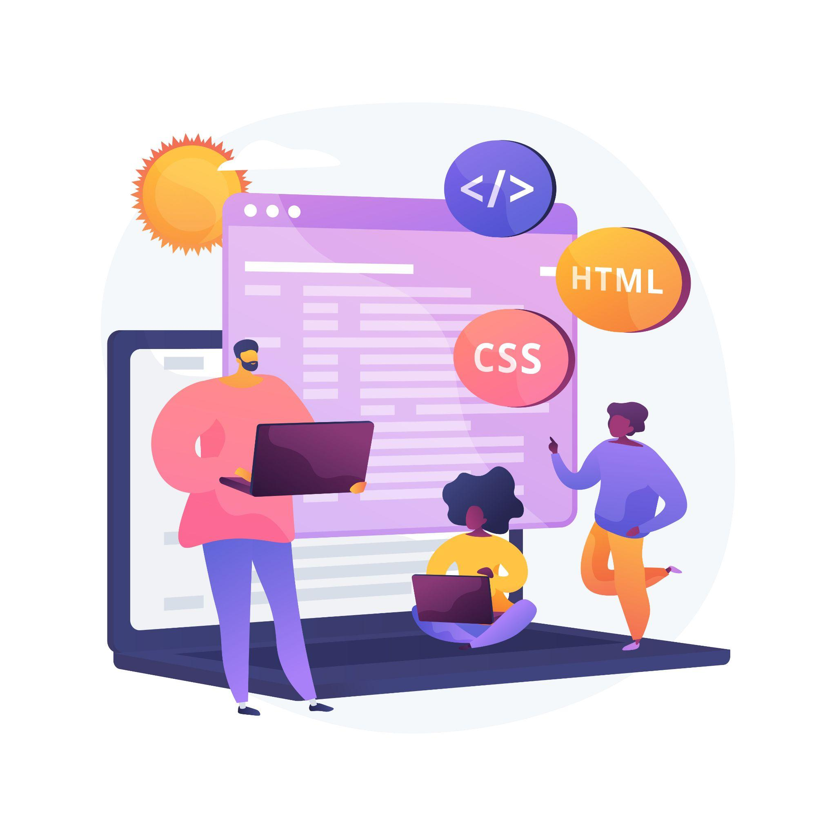
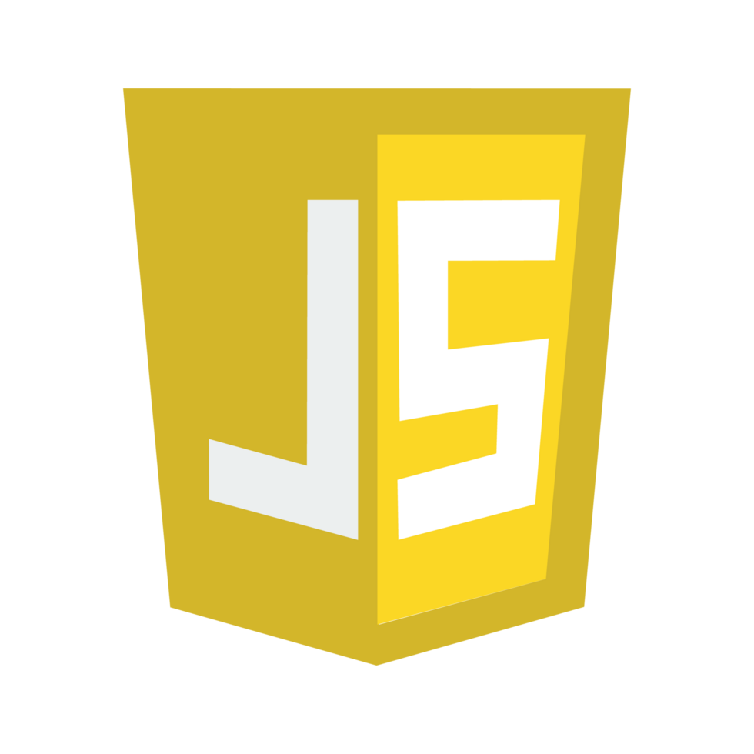


Lecture 14:
Event Loop
Course - Web Development - II
-By
Instructor Name
‹#›
welcome@krmangalam.edu.in
Sohna Road,Gurugram,Haryana 122103

Slide 2

| Table of Contents
Event Loop & Task Queue
Understanding Web APIs & Browser Internals
References.
The End.
‹#›

Slide 3

|
Have you ever wondered how JavaScript handles things that take time, like setTimeout or fetch? We know that JavaScript runs one line at a time… so who decides when these delayed tasks should come back and run? How do they know when it's their turn?
‹#›

Slide 4
|
Have you ever wondered how JavaScript handles things that take time, like setTimeout or fetch? We know that JavaScript runs one line at a time… so who decides when these delayed tasks should come back and run? How do they know when it's their turn?
Big thanks to these 4 silent heroes behind the scenes:
Call Stack – the place where all code runs, one line at a time.
Web APIs – they handle time-consuming stuff like timers or HTTP requests.
Task Queue – where the completed tasks wait in line to be executed.
Event Loop – the manager that decides when a task can go to the Call Stack.
they make sure JavaScript doesn’t freeze, keeps running smoothly, and still knows exactly when to run delayed tasks
‹#›

Slide 5
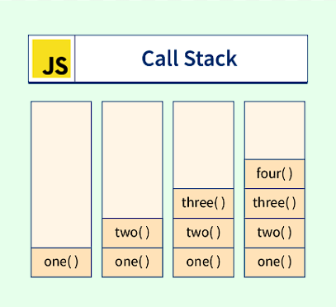
| Call Stack
The Call Stack is a place where JavaScript keeps track of the functions that are currently running.
JavaScript runs code one line at a time (it is single-threaded), and uses the Call Stack to remember which function is currently executing and where to return after the function ends.
‹#›

Slide 6
| Web API
Web Application Programming Interfaces are tools provided by the browser (not JavaScript) that help us perform asynchronous or background tasks —
like waiting for time, fetching data, or handling events — without blocking the main program.
Task | Web API Used
Wait for time | setTimeout()
Make network request | fetch()
Handle button click | addEventListener()
Listen for key press | keydown
Work in background | Web Workers
‹#›

Slide 7
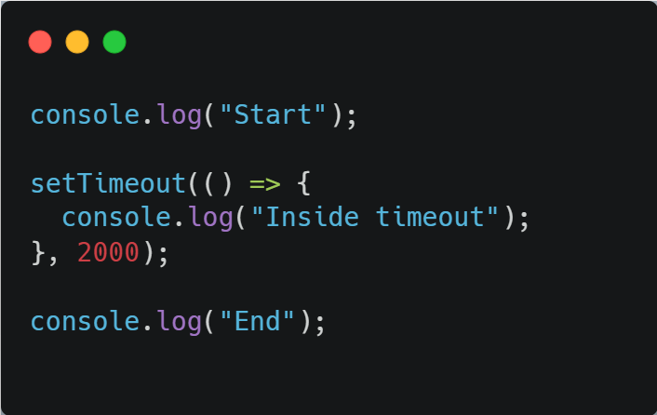
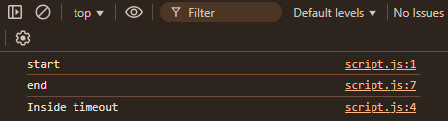
| Web API
Web api
‹#›

Slide 8

|
Have you ever wondered JavaScript can only do one thing at a time, right? That’s why it uses the Call Stack to keep track of what to do next. But when we use async code that goes to the Web API zone and when the Web API finishes its job Can it directly jump into the Call Stack ? Who decides when that task can finally go into the Call Stack?
‹#›

Slide 9
|
Have you ever wondered JavaScript can only do one thing at a time, right? That’s why it uses the Call Stack to keep track of what to do next. But when we use async code that goes to the Web API zone and when the Web API finishes its job can it directly jump into the Call Stack ? Who decides when that task can finally go into the Call Stack?
No, the Web API can’t directly jump into the Call Stack.
Once it finishes its job, it sends the task to the Task Queue.
But even Task Queue doesn’t push the task — it just waits there patiently.
‹#›

Slide 10
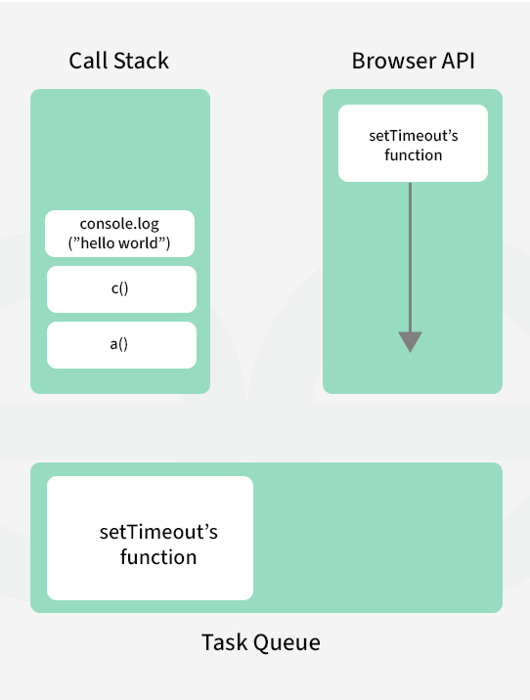
| Task Queue
Task Queue is a waiting line for functions that are ready to run after Web API finishes its work, but they have to wait until the Call Stack is empty.
It stores asynchronous callbacks (like the function inside setTimeout)
Waiting for the Call Stack to be empty
‹#›

Slide 11
| Task Queue
Remember, JavaScript runs one task at a time using the Call Stack. And when we use functions like setTimeout, fetch, or DOM events, they go to the Web API, right?
Can Web API directly send results to Call Stack? → No!
If Web API can’t push the function back into the Call Stack, who helps it?
Task Queue
‹#›

Slide 12
| Task Queue
Types of Task Queues :
JavaScript mainly has two types of task queues:
1. Macrotask Queue ( Low Priority )
2. Microtask Queue (High Priority)
‹#›

Slide 13
| Task Queue
Macrotask Queue (Task Queue)
The Macrotask Queue contains tasks that are executed after the current call stack is empty and after all microtasks are completed.
These tasks usually represent larger or delayed operations.
Examples of Macrotasks:
setTimeout()
setInterval()
DOM events (click, keydown, submit)
setImmediate() (Node.js)
I/O operations (Node.js)
How Macrotask Queue works:
A task waits in the queue.
Event Loop checks if the Call Stack is empty.
If Microtask Queue is empty, one macrotask is moved to the Call Stack.
That task is executed completely.
‹#›

Slide 14
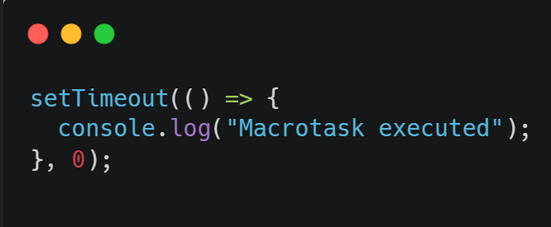
| Task Queue
Example:
‹#›

Slide 15
| Task Queue
Microtask Queue (High Priority Queue)
The Microtask Queue has higher priority than the Macrotask Queue.
Microtasks are executed immediately after the current script finishes, before any macrotask runs.
Examples of Microtasks:
Promise.then()
Promise.catch()
Promise.finally()
queueMicrotask()
MutationObserver
‹#›

Slide 16
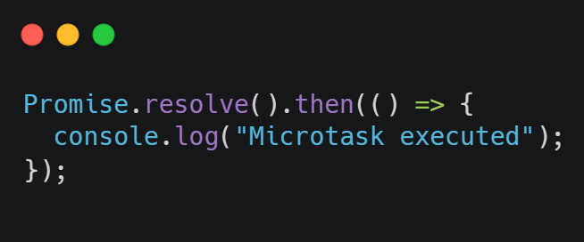
| Task Queue
How Microtask Queue works:
After the Call Stack becomes empty, Event Loop checks Microtask Queue.
All microtasks are executed one by one.
Only after the Microtask Queue is completely empty, the Event Loop moves to the Macrotask Queue.
‹#›

Slide 17
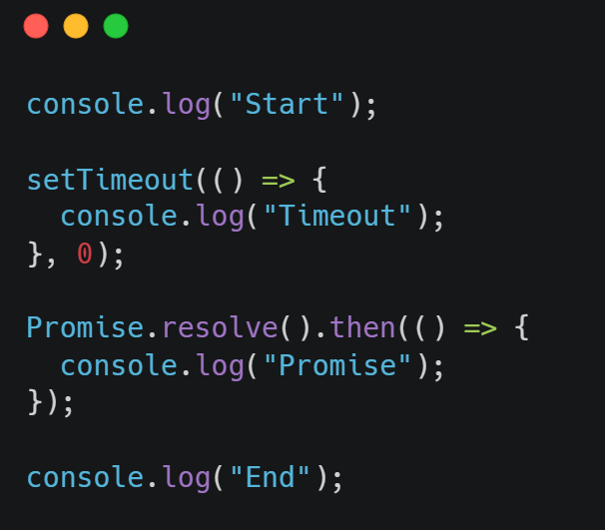
| Task Queue
Microtask vs Macrotask (Execution Rule)
📌 Important Rule of Event Loop:
The Event Loop always executes all Microtasks first, then one Macrotask.
‹#›

Slide 18
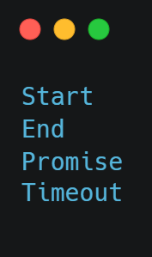
| Task Queue
Output :
‹#›

Slide 19
|
Have you ever wondered… when Call Stack is busy, Web APIs are handling timeouts or fetch, Task Queue is filling up, then who’s making sure everything runs so smoothly, one after another, in the right order?
‹#›

Slide 20
|
Have you ever wondered… when Call Stack is busy, Web APIs are handling timeouts or fetch, Task Queue is filling up, then who’s making sure everything runs so smoothly, one after another, in the right order?
Big thanks to the Event Loop!
It’s the real manager behind the scenes.
Event Loop is like a manager or guard who keeps checking if the Call Stack is empty, and if yes, it sends the next task from the Task Queue to the Call Stack
‹#›

Slide 21
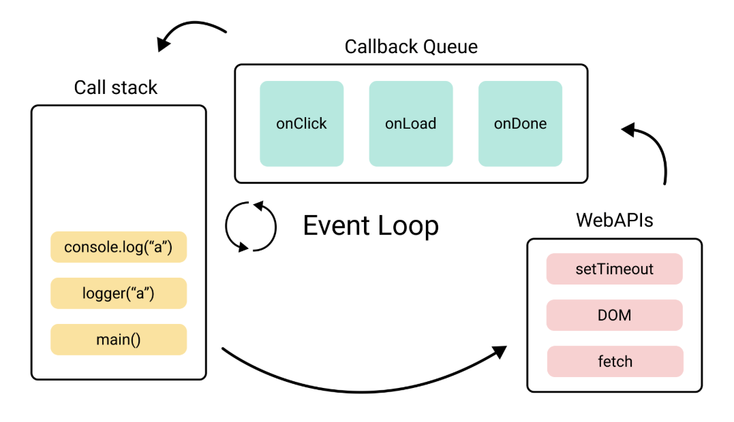
| Event Loop
‹#›

Slide 22
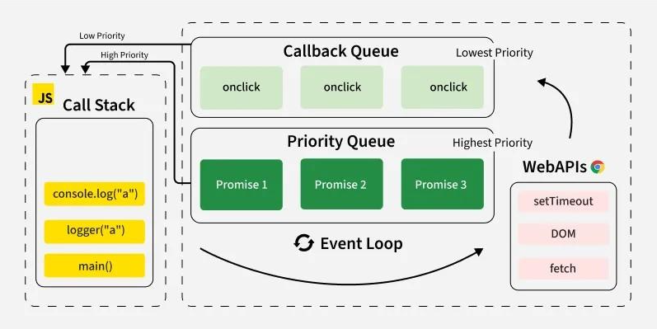
| Event Loop
‹#›

Slide 23

| Check Your Understanding
Question : In the Event Loop, do Promise callbacks (.then, .catch) generally have priority over
setTimeout callbacks?
Options : a) No, setTimeout always runs first.
b) Yes, because they are placed in the Microtask Queue, which is processed before the Macrotask Queue.
c) No, their priority is random.
d) Yes, because Promises are a newer feature.
Answer : b) Yes, because they are placed in the Microtask Queue, which is processed
before the Macrotask Queue.
Explanation:
The Event Loop prioritizes tasks from the Microtask Queue (where promise callbacks go) over the Macrotask/Callback Queue (where setTimeout callbacks go). The entire Microtask Queue is emptied before the next Macrotask is processed.
‹#›

Slide 24
| References
MDN Web Docs : Comprehensive and official documentation for JS. 🔗https://developer.mozilla.org/en-US/docs/Web/JavaScript
W3Schools – JS Tutorial : Beginner-friendly JS tutorials with examples and interactive editors. 🔗 https://www.w3schools.com/js/
JavaScript.info - A comprehensive tutorial-style website that covers core JavaScript concepts in depth.
🔗https://javascript.info/
‹#›

Slide 25
Thanks
For
Watching
Course - Web Development - II
‹#›
welcome@krmangalam.edu.in
Sohna Road,Gurugram,Haryana 122103

